Slide 1
Modernization and Migration Management (M3) Framework M3 Playbook Orientation
GSA Office of Shared Solutions and Performance Improvement (OSSPI)

Slide 2

Overview and Agenda
Modernization and Migration Challenges (slide 3)
M3 Framework Introduction (slide 4)
What is the M3 Playbook? (slide 6)
M3 Playbook Journey (slide 8)
M3 Playbook Annual Update Objectives (slide 9)
Quality Service Management Offices (QSMOs) and the M3 Playbook (slide 10)
M3 Playbook Intended Use (slide 12)
Phases of the M3 (slide 15)
Benefits to M3 Playbook Users (slide 23)
Resource Materials (slide 24)
How to Get Involved (slide 25)
- Last updated March 2023 -

Slide 3




Modernization and Migration Challenges
The M3 Framework provides lessons learned to reduce risk and address challenges inherent in any Federal agency modernization or migration effort.
Stakeholder Identification and Support
Structured Planning Approach
Building a Strong Business Case
Avoiding Scope Creep
- Last updated March 2023 -

Slide 4
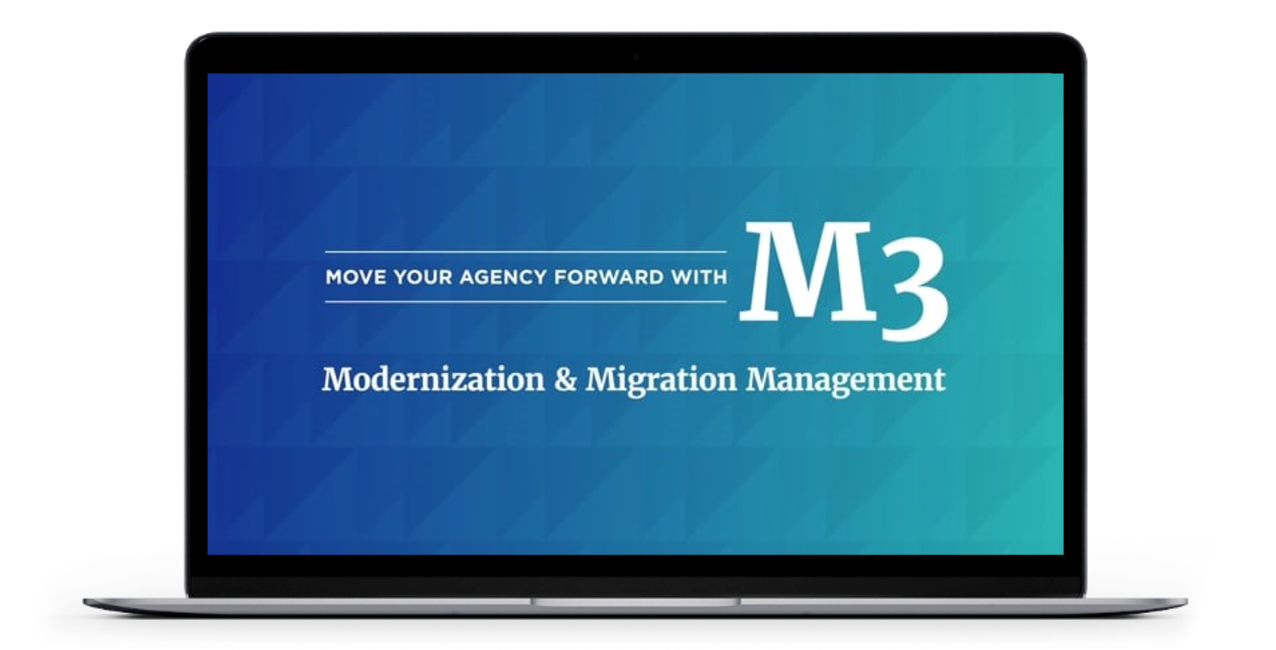

M3 Framework Introduction - Video
- Last updated March 2023 -

Slide 5
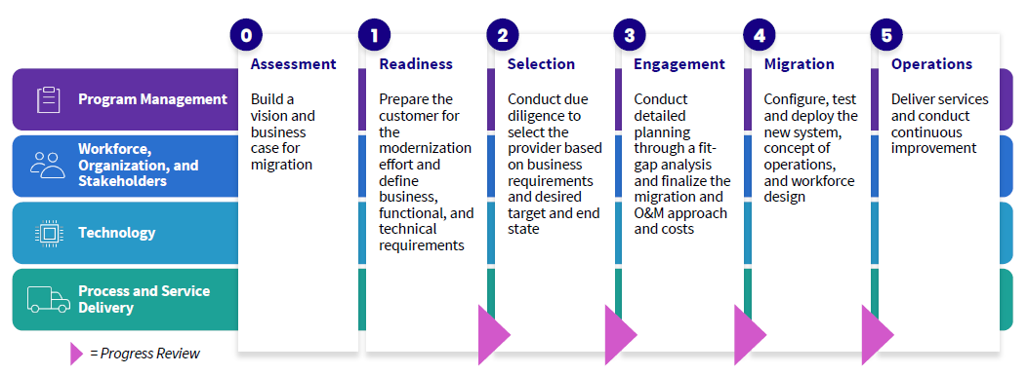
M3 Framework Introduction
The M3 Framework is a roadmap designed to help Federal agencies achieve successful outcomes in their system and/or service modernizations and migration initiatives.
The M3 Framework segments modernizations and migrations into six discrete phases. Each phase includes a series of objectives and recommended activities that are grouped across four workstreams Program Management, Workforce, Organization and Stakeholders, Technology, and Process and Service Delivery.
- Last updated March 2023 -

Slide 6




What is the M3 Playbook?
The M3 Playbook is a collection of tools, templates, and lessons learned designed to help Federal agencies and shared services provider organizations plan for and execute modernization and migration projects of all types, and levels of complexity.
The M3 Playbook is not a prescriptive process document – it is a roadmap, founded on industry project management best practices. It is aligned to government-wide Business Standards and the Federal Shared Services ecosystem; it will add value and improve the likelihood of success for agency modernization projects.
25+ Documentation Templates
Best Practices
Template documents that include comprehensive guidance to aid Federal agencies and shared services providers in the completion of activities and provide key considerations.
Based on feedback from over 100 government and industry experts, reflects best practices and lessons learned from prior migrations.
70+ Guided Activities
Prior Agency Examples
Descriptions for how to apply the M3 framework, including detailed activity steps, inputs, outputs, lessons learned, and stakeholders involved.
A repository that includes sample documentation from previous modernization and migration projects.
M3 Playbook
- Last updated March 2023 -

Slide 7
M3 Playbook Journey
This timeline illustrates the recent history and progression of the M3 Playbook
OMB-M-19-16 Release
Annual Updates
Stakeholder Engagement
OMB-M-19-16 released, formally establishing Quality Service Management Offices (QSMOs) and resetting the operating model for delivering common services
Synthesize feedback to initiate future annual updates of the M3 Playbook
With Federal agencies, shared services providers, and QSMOs to drive the comprehensive update
2018
2019
2020
2021
Future
FY18 Update
OMB-M-21-20 Release
FY21 Update
First iteration of the M3 Playbook released for use government-wide
OMB-M-21-20 released, directing Federal agencies to engage with QSMOs prior to their modernizations to support execution of the American Rescue Plan (ARP)
Reimagined the look and feel of the M3 Playbook to enhance user experience, improve outcomes, and reduce risk during system and services modernizations and migrations
- Last updated March 2023 -

Slide 8

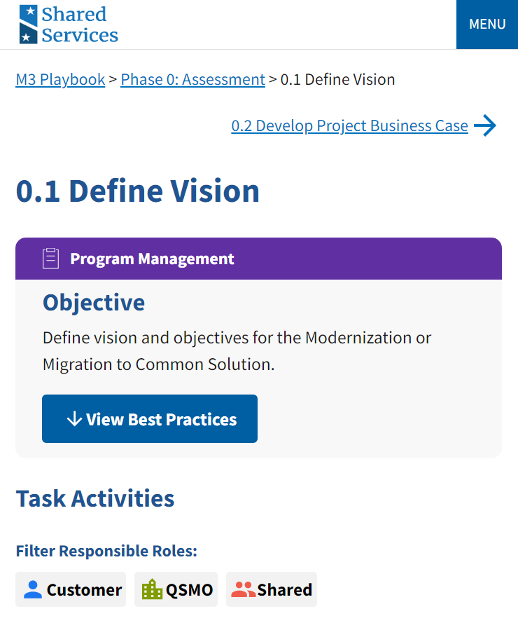
M3 Annual Update Objectives
M3 Playbook Orientation Session
The M3 Playbook is updated on an annual basis. These updates are influenced by feedback collected through engagement with Federal agencies, shared services providers, the QSMOs, and other key stakeholders. The high-level objectives of the annual updates include:
Soliciting Customer Feedback
Comprehensive Content Review and Updates
Incorporating New Value-Add Activities
Aligning the Playbook to Authoritative Policy Guidance
Incorporating Modernization Best Practices
8
- Last updated March 2023 -

Slide 9



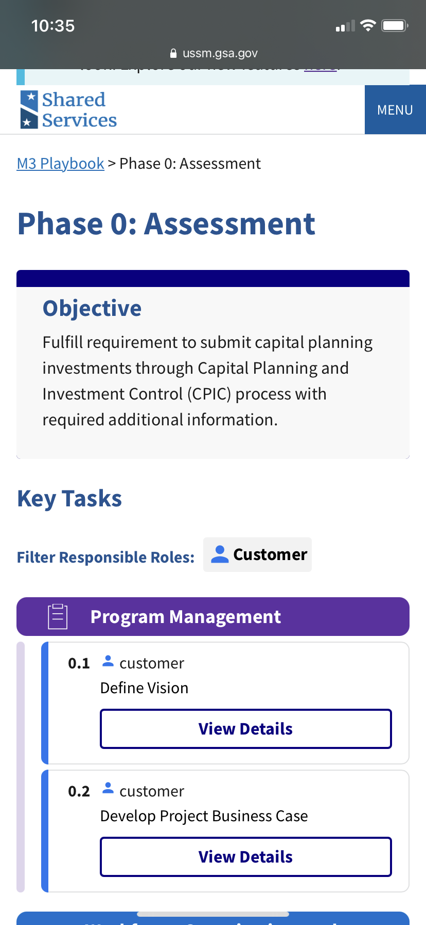

M3 Playbook Update Highlights
An overview of the key updates included in the most recent comprehensive M3 Playbook update is included for reference below.
Added QSMOs as a Responsible Party and incorporating the role of the QSMO as a stakeholder throughout various activities
Alignment with government wide initiatives and authorities including the Business Standards, Investment Planning Process and OMB Memorandum 19-16
Streamlined content and additional materials that help agencies plan for and execute their modernization projects
Improved user experience by re-designing and development of a new M3 website
- Last updated March 2023 -

Slide 10




QSMOs and the M3 Playbook
The Office of Management and Budget (OMB) formally designated Quality Service Management Offices (QSMOs) to serve as governmentwide storefronts, offering modern technology and transaction processing solutions to drive scale, standardization and efficiency. The M3 Playbook provides a set of best practices and guidance for engaging with the appropriate QSMO as Federal agencies implement solutions from the QSMO Marketplace.
Housed in Federal agencies with the mission and expertise to deliver standard capabilities for Federal agencies government-wide, QSMOs:
Offer and manage a marketplace of solutions for common technology and services in response to agency needs
Institute a Federal agency engagement and feedback model, using human-centered design principles, to allow continuous improvements and performance management of solutions
Guide and govern the long-term sustainability of the services and solutions marketplace
Drive the implementation of standards established through the collaborative governance process that produce efficiencies in process and scale
- Last updated March 2023 -
Notes:
Their main goal is to improve service delivery, enhance customer satisfaction, and create high value work.

Slide 11
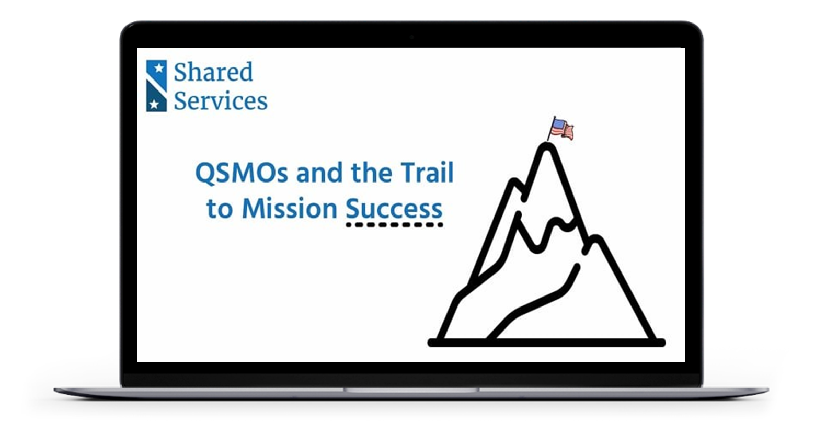
Quality Service Management Office (QSMO) - Video
- Last updated March 2023 -

Slide 12

M3 Playbook Intended Use
Designed as a flexible guide to increase the likelihood of success as Federal agencies modernize and migrate their mission support functions, the M3 Playbook can be used as a role-based, step by step process document, or as a reference guide depending on customer and stakeholder needs.
Federal
Agencies
Shared Services Providers
OMB
OSSPI
QSMOs
Agency executives to project managers leverage the M3 Playbook to develop an understanding of how to approach and execute a shared services modernization project
Provides a reference tool when guiding Federal agencies through the shared services migration process
Provides a consistent format for Federal agencies to communicate updates during the Investment Planning process and throughout modernization initiatives
Plays a facilitation and coordination role building awareness and increased use of the M3
QSMOs use M3 to partner with Federal agencies throughout all phases of their modernization journeys
- Last updated March 2023 -

Slide 13

Federal Agencies
Below is a non-exhaustive list of scenarios detailing how Federal agencies can use the M3 Playbook when conducting their system and services modernizations and migrations:
Build and establish a vision and business case for modernization and/or migration
Conduct initial market research with QSMOs to identify what currently exists in the QSMO Marketplace
Define and understand business, functional, and technical requirements
Regularly engage with QSMOs throughout Project Business Case development
Select a shared services provider based on capabilities and desired target end state
Conduct detailed planning and set up progress reviews with your leadership and your executive steering committee
Communicate with QSMOs to support migration
Identify and design target state organization needs and prepare for changes to the workforce
Configure, test, and deploy your new system, concept of operations, and workforce design
Deliver services and monitor performance while implementing continuous improvements
- Last updated March 2023 -

Slide 14

Shared Services Providers
Below is a non-exhaustive list of scenarios detailing how shared services providers can use the M3 Playbook when assisting in system and services modernizations and migrations:
Engage with Federal agencies to provide relevant information as they define their Scope of Services
Assist Federal agencies in defining Migration Approach and roadmap
Develop and manage program management documentation
Assist in onboarding shared services provider Program Management Office (PMO) lead and team and integrate governance structure and risk processes
Work with QSMOs to assist in migration path forward as necessary
Partner with Federal agencies to identify functional and technical requirements and provide solutions to resolve gaps
Help monitor, measure, and communicate program migration process
Migrate in-scope processes and assist in designing the transformed organization for the future state environment
Monitor the success of the migration and conduct continuous process improvements and customer care activities
- Last updated March 2023 -

Slide 15
Phases of M3 - Video
- Last updated March 2023 -

Slide 16
Phases of the M3
The M3 Framework segments modernizations and migrations into six discrete phases: (0) Assessment, (1) Readiness, (2) Selection, (3) Engagement, (4) Migration, and (5) Operations. Each phase includes a series of objectives and recommended activities that are grouped across the four workstreams. Each of the phases are detailed on the following slides.
- Last updated March 2023 -

Slide 17
Phase 0: Assessment
Key Activities*
Build and define a vision and objectives to determine optimal path for modernization or migration effort
Identify in-scope service area(s) and their function(s) provided through the Federal Integrated Business Framework (FIBF) website (e.g. financial management, human capital, acquisition, grants management, travel)
= Progress Review
Conduct initial market research with QSMOs to identify and understand the current offerings available within the QSMO Marketplace
Example Inputs
Example Outputs
Government-wide Standards defined through the FIBF website
Vision Statement
In-scope Service Area(s) and Function(s)
Expected Benefits
High Level Timelines
Solicit information from relevant QSMOs in the planning process as needed when defining the Scope of Services
Develop the Project Business Case for funding using activity and output resources including existing performance metric data to assist in identifying performance targets
Example Stakeholders
Executive Sponsor
Organization Executives (CXOs)
Program Manager
PMO Lead, if on-boarded
QSMO
Finalize vision statement, expected benefits, and high-level timelines
* Learn more about the Assessment phase activities and templates by clicking here
- Last updated March 2023 -
Notes:
Their main goal is to improve service delivery, enhance customer satisfaction, and create high value work.

Slide 18
Phase 1: Readiness
Key Activities*
Conduct Business Readiness Assessment to identify gaps between agency’s existing solution and target end state
Establish customer PMO structure, staff, and processes to manage program activities
Develop governance structure that establishes program activity ownership and decision-making authority
= Progress Review
Example Inputs
Example Outputs
Establish risk management plans and processes
Project Business Case
Vision Statement
As-Is Workforce Documentation
Current Organization Structure
Business Readiness Assessment
Communications Plan
Migration and O&M training needs
Set performance and success metrics including compliance, process, and workload measures to define baselines and target metrics
Conduct thorough stakeholder analysis and develop a detailed Communications Plan
Example Stakeholders
Document business capabilities, mission critical, and unique capabilities of the customer organization to support the Business Readiness Assessment
PMO Team
Change Management Lead
Communications Lead
Executive Sponsor
Business Owner
Program Manager
QSMO
Research and engage with QSMOs on available solution offerings within the marketplace
* Learn more about the Readiness phase activities and templates by clicking here
- Last updated March 2023 -
Notes:
Their main goal is to improve service delivery, enhance customer satisfaction, and create high value work.

Slide 19
Phase 2: Selection
Key Activities*
Conduct due diligence to select a shared services provider based on capabilities, business requirements, and desired target end state
Monitor and report on program progress
Execute risk management processes to identify and mitigate risks and issues throughout migration
= Progress Review
Design labor relations outreach strategy and engage with unions
Example Inputs
Example Outputs
Update Change Management Plan based on selected shared services provider and deliver communications to engage stakeholders prior to the migration
Scope of Services
Business Capabilities
Business Needs Workbook
Acquisition Strategy
Implementation Approach/Schedule
Change Management Plan
Communications Plan
Status Reports/Dashboards
Conduct initial data cleansing activities
Example Stakeholders
Understand as-is business processes including the current state environment, existing challenges, and opportunities for improvement / standardization
Executive Sponsor
Organization Executives (CXOs)
Program Manager
Functional Lead
Functional SME
Technical Lead/Solution Architect
Technical SME
QSMO
* Learn more about the Selection phase activities and templates by clicking here
- Last updated March 2023 -
Notes:
Their main goal is to improve service delivery, enhance customer satisfaction, and create high value work.

Slide 20
Phase 3: Engagement
Key Activities*
Monitor, measure, and report on program migration progress
Continue to execute risk management processes to identify and mitigate risks and issues
Develop migration approach, schedule, and cost based on Business Readiness Assessment
Continue to engage and communicate with labor relations to obtain approval towards shared services migration
= Progress Review
Example Inputs
Example Outputs
Maintain and execute Change Management and Communications Plans based on feedback from previous phases
Resource Management Plan
Governance Plan
Provider Agreement
Resource Management Plan
Change Request Form
Change Management Plan
Develop plan and approach for training curriculum, design, development, delivery, and evaluation
Conduct requirements fit-gap analysis and develop solutions to inform migration approach, timeline, and revised cost estimates
Example Stakeholders
Executive Sponsor
Business Owner
Program Manager
PMO Lead
PMO Team
Functional Lead
Technical Lead/Solution Architect
QSMO
Finalize target state systems environment that captures all required interfaces, application, security/privacy, and data layers
* Learn more about the Engagement phase activities and templates by clicking here
- Last updated March 2023 -
Notes:
Their main goal is to improve service delivery, enhance customer satisfaction, and create high value work.

Slide 21
Phase 4: Migration
Key Activities*
Build, test, and deploy the new system, concept of operations, and workforce design
Monitor, measure, and communicate program migration progress
Develop Operations and Maintenance (O&M) governance structure to manage and oversee system and process performance
= Progress Review
Design the target state process maps, activities, decision points, interrelationships, and systems interactions
Example Inputs
Example Outputs
Requirements Traceability Matrix (RTM)
Requirements Fit-Gap Analysis
Target State Organization Design
Labor Relations Strategy
Risk Management Plan
Risks, Actions, Issues, and Decisions (RAID) Log
M3 Risk Assessment Tool
Identify and design target state organization needs and prepare for changes to the workforce
Configure enhancements of system software, hardware, and documentation throughout the lifecycle
Example Stakeholders
Develop and deliver training to the organization to prepare for Go-Live
Executive Sponsor
Business Owner
Program Manager
PMO Team
Information Systems Security Officer (ISSO)
Change Management Lead
QSMO
Monitor program performance and measure against Go-Live criteria to assess program’s readiness for Go-Live
* Learn more about the Migration phase activities and templates by clicking here
- Last updated March 2023 -
Notes:
Their main goal is to improve service delivery, enhance customer satisfaction, and create high value work.

Slide 22
Phase 5: Operations
Key Activities*
Deliver services and conduct continuous process improvement
Evaluate and measure migration’s performance and success to identify successes and areas for improvement
Implement O&M governance structures to manage and oversee performance after Go-Live
= Progress Review
Example Inputs
Example Outputs
Maintain regular communication with stakeholders and assess effectiveness of the training after migration is complete
Requirements Traceability Matrix (RTM)
Target State Systems Environment
Cutover Plan
Service Level Agreements (SLAs)
Lessons Learned Report
Post Implementation and Evaluation Report
Decommission Report
Retire legacy systems including hardware, software, licenses, interface, and close out support contracts
Example Stakeholders
Monitor operational performance to address system and user’s concerns and implement process improvement opportunities
Executive Sponsor
Business Owner
Program Manager
PMO Lead
PMO Team
O&M Team
QSMO
* Learn more about the Operations phase activities and templates by clicking here
- Last updated March 2023 -
Notes:
Their main goal is to improve service delivery, enhance customer satisfaction, and create high value work.

Slide 23

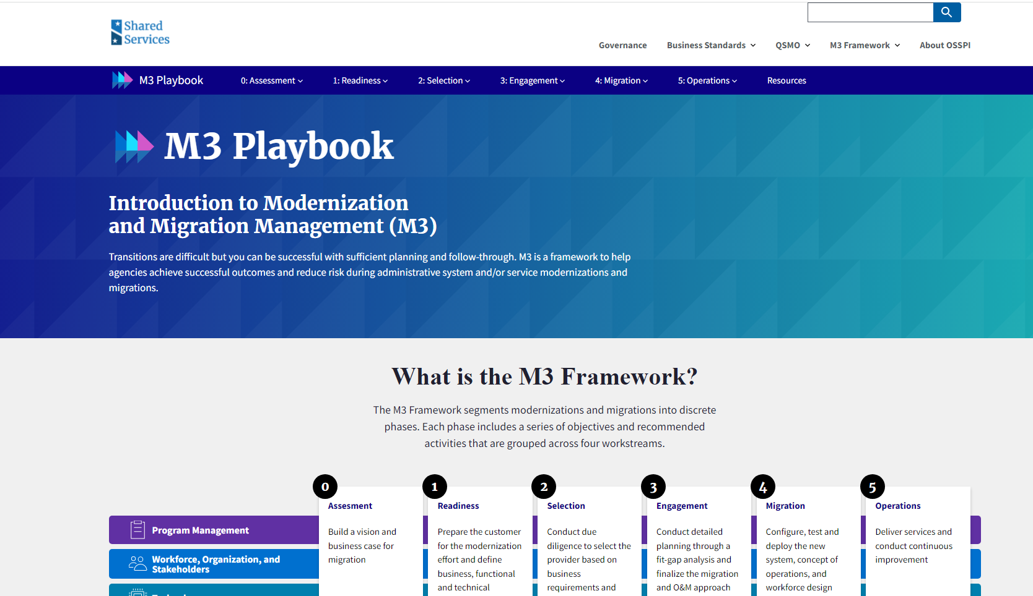
Benefits to M3 Playbook Users
The M3 Playbook provides value to the broader Federal Shared Services community and stakeholder groups government-wide – an overview of the key benefits are included below:
Consistency in approach
Straight-forward roadmap
Easily accessible guidance information
Standardized templates and documentation
Leverages lessons learned and best practices
Recommended by OMB and GAO
Promotes consistency in project reporting using a common language
Bottom line: gain efficiencies,
reduce risk, minimize implementation time, and ultimately improve results!
- Last updated March 2023 -

Slide 24
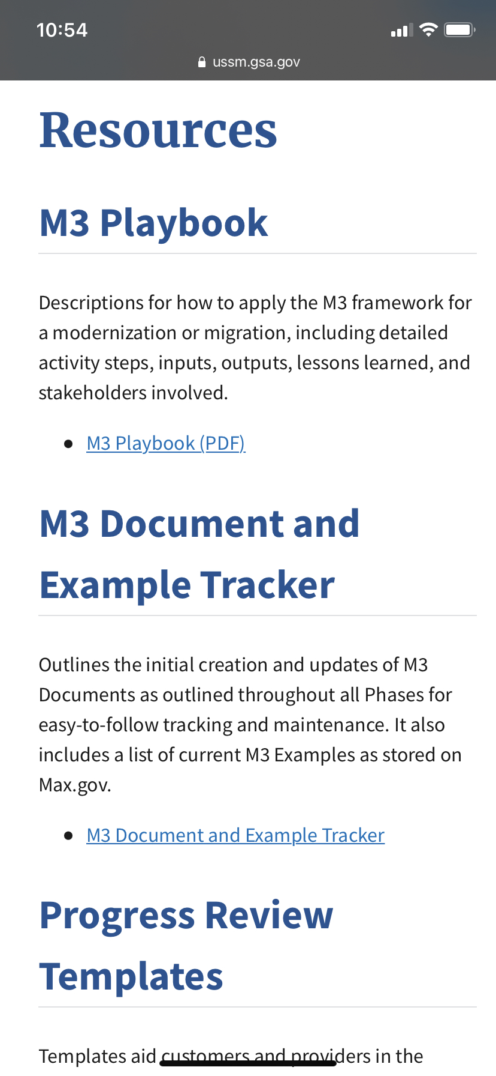
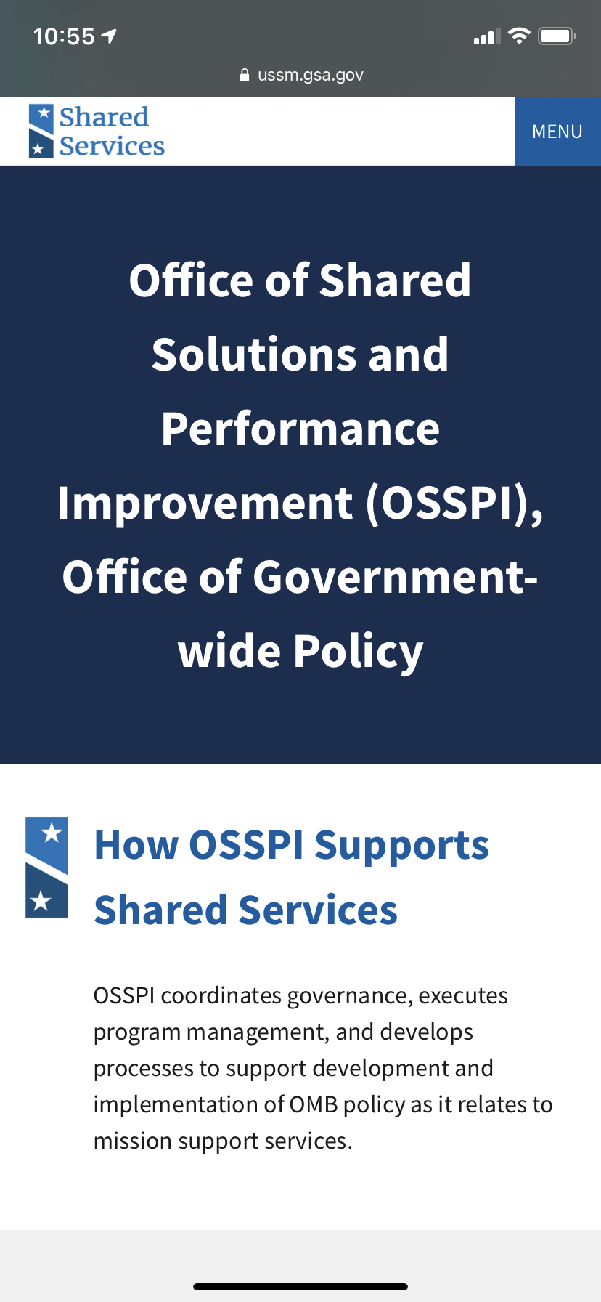
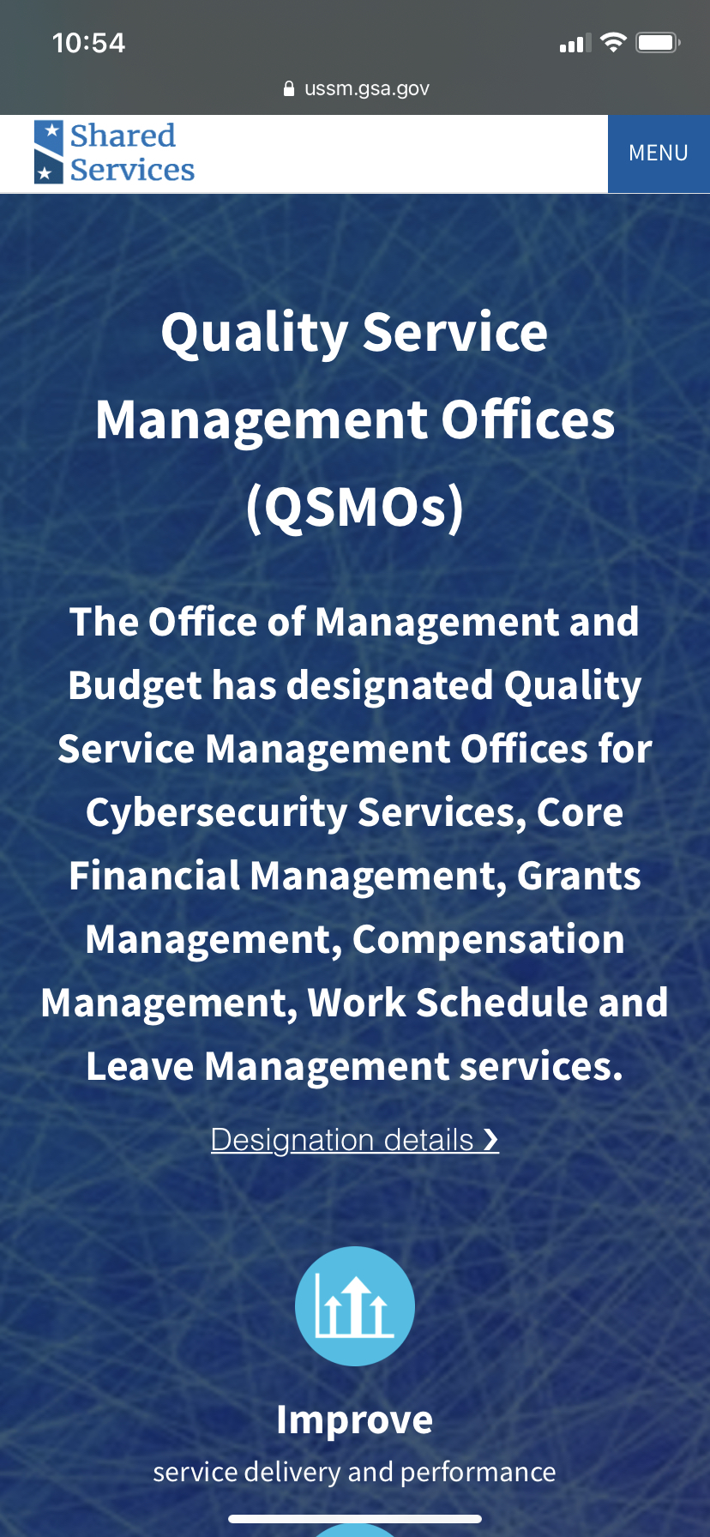
Resource Materials
Below are a few useful resource materials to assist you in your modernization journey.
M3 Playbook Website
M3 Playbook Resources Tab
M3 Playbook Download (pdf)
OSSPI Website
QSMO Website
- Last updated March 2023 -

Slide 25
HOW CAN YOU GET INVOLVED?
Help build awareness of the M3 Playbook and its benefits by identifying additional channels within your community that would benefit from an introductory presentation
Send any questions or feedback to OSSPI at osspi.sharedservices@gsa.gov
Check out the M3 website here: M3 Playbook
- Last updated March 2023 -

